Slide 1

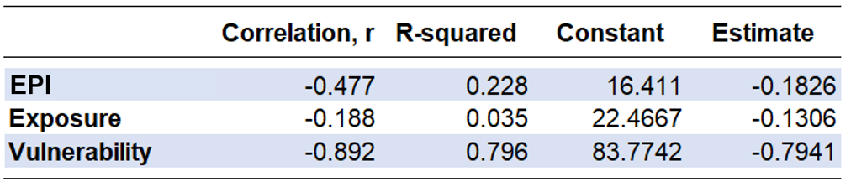
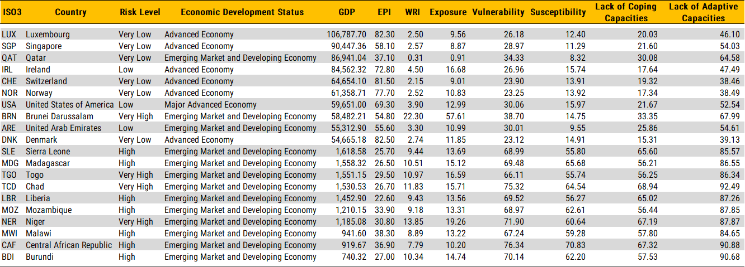
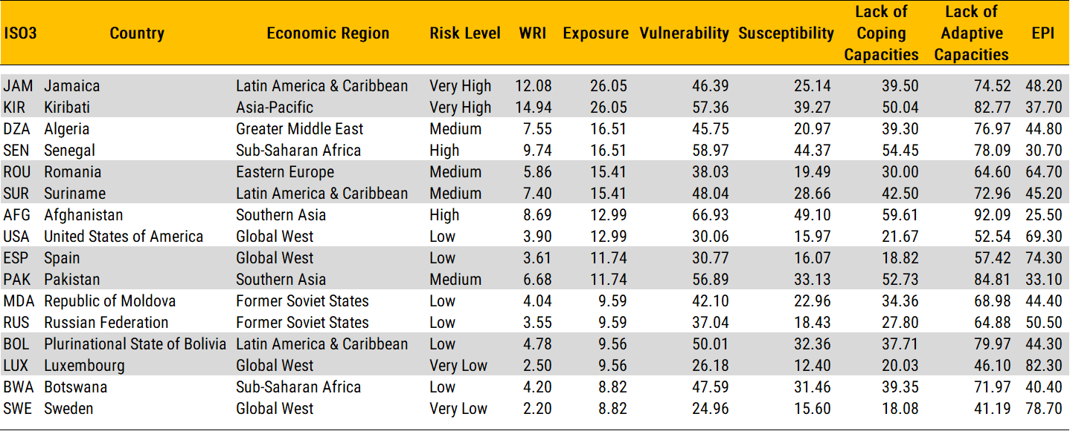
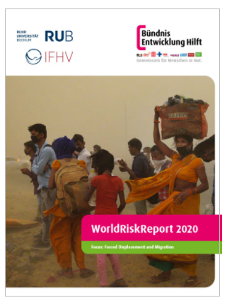
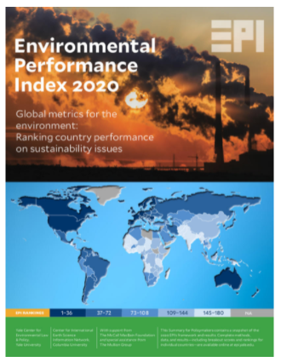
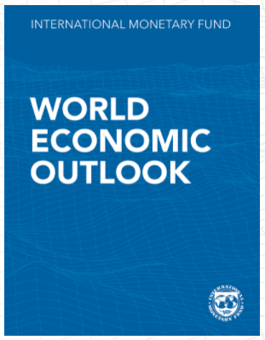
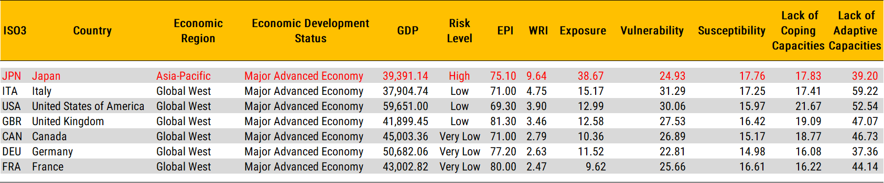
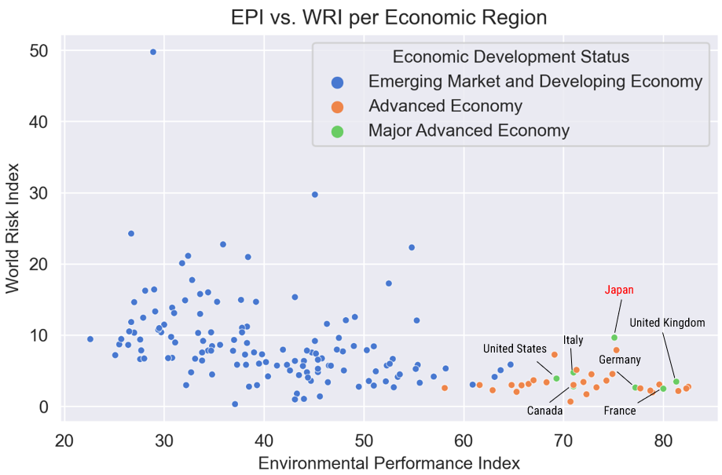
Linking Disaster Risk and
Environmental Sustainability
JONNEL S. ACOBA, THE MAXWELL SCHOOL OF CITIZENSHIP AND PUBLIC AFFAIRS
MOTIVATION
ANALYSIS
ANALYSIS
Over the years, destructive natural disasters have adversely impacted economies, claimed lives, and damaged properties. Various literatures posit that aside from inherent [exposure] risk of countries, the prevalence of devastating natural disasters is predicated by the worsening state of the environment (climate change).
Research Questions:
Is there a relationship between EPI and WRI?
What does EPI tell about the exposure and vulnerability of countries to natural disasters?
What does the location and/or economic development status of a country tell about its WRI and EPI?
Performance in environmental sustainability management (EPI) is negatively correlated with the risk of natural disaster (WRI).
Advanced economies perform better in addressing environmental sustainability issues, hence with lower risk of natural disaster*.
EPI has a stronger correlation with a country's risk vulnerability than its exposure.
Policy significance
DATA
Potential study focus [new dimension of public sector performance audits] in reevaluating environmental sustainability management efforts, especially for inherently risky countries (many developing countries)
Benchmarking for best practices around the world but limited to initiatives addressing susceptibility, coping and adaptation (institutions and management).
May guide policy decisions on reallocation of humanitarian and other development aids from regional development partners and other agencies.
The World Risk Index (WRI) Report from 2016 to 2020. The 2020 WRI Report ranked 181 countries around the word according to their risk of becoming a victim of extreme natural event. WRI is a function of Exposure and Vulnerability. Exposure refers to inherent risk of a country and Vulnerability pertains to the mean of Susceptibility, Lack of Coping Capacities, and Lack of Adaptive Capacities.
The 2020 Environmental Performance Index (EPI) Report ranked 180 countries according to their performance in addressing environmental sustainability issues. The EPI assessment uses 32 metrics or indicators summed up in two components: Environmental Health and Ecosystem Vitality.
Utilized economic and socio-demographic data from the 2020 World Economic Outlook Report downloaded from the International Monetary Fund (IMF) website.
REFERENCES
World Risk Report 2020. Bündnis Entwicklung Hilft, Ruhr University Bochum – Institute for International Law of Peace and Conflict 2020.
Welle, Torsten & Birkmann, Joern. (2015). The World Risk Index – An Approach to Assess Risk and Vulnerability on a Global Scale. Journal of Extreme Events. Volume 2. 10.1142/S2345737615500025.
Wendling, Z. A., Emerson, J. W., de Sherbinin, A., Esty, D. C., et al. (2020). 2020 Environmental Performance Index. New Haven, CT: Yale Center for Environmental Law & Policy. epi.yale.edu

Slide 2
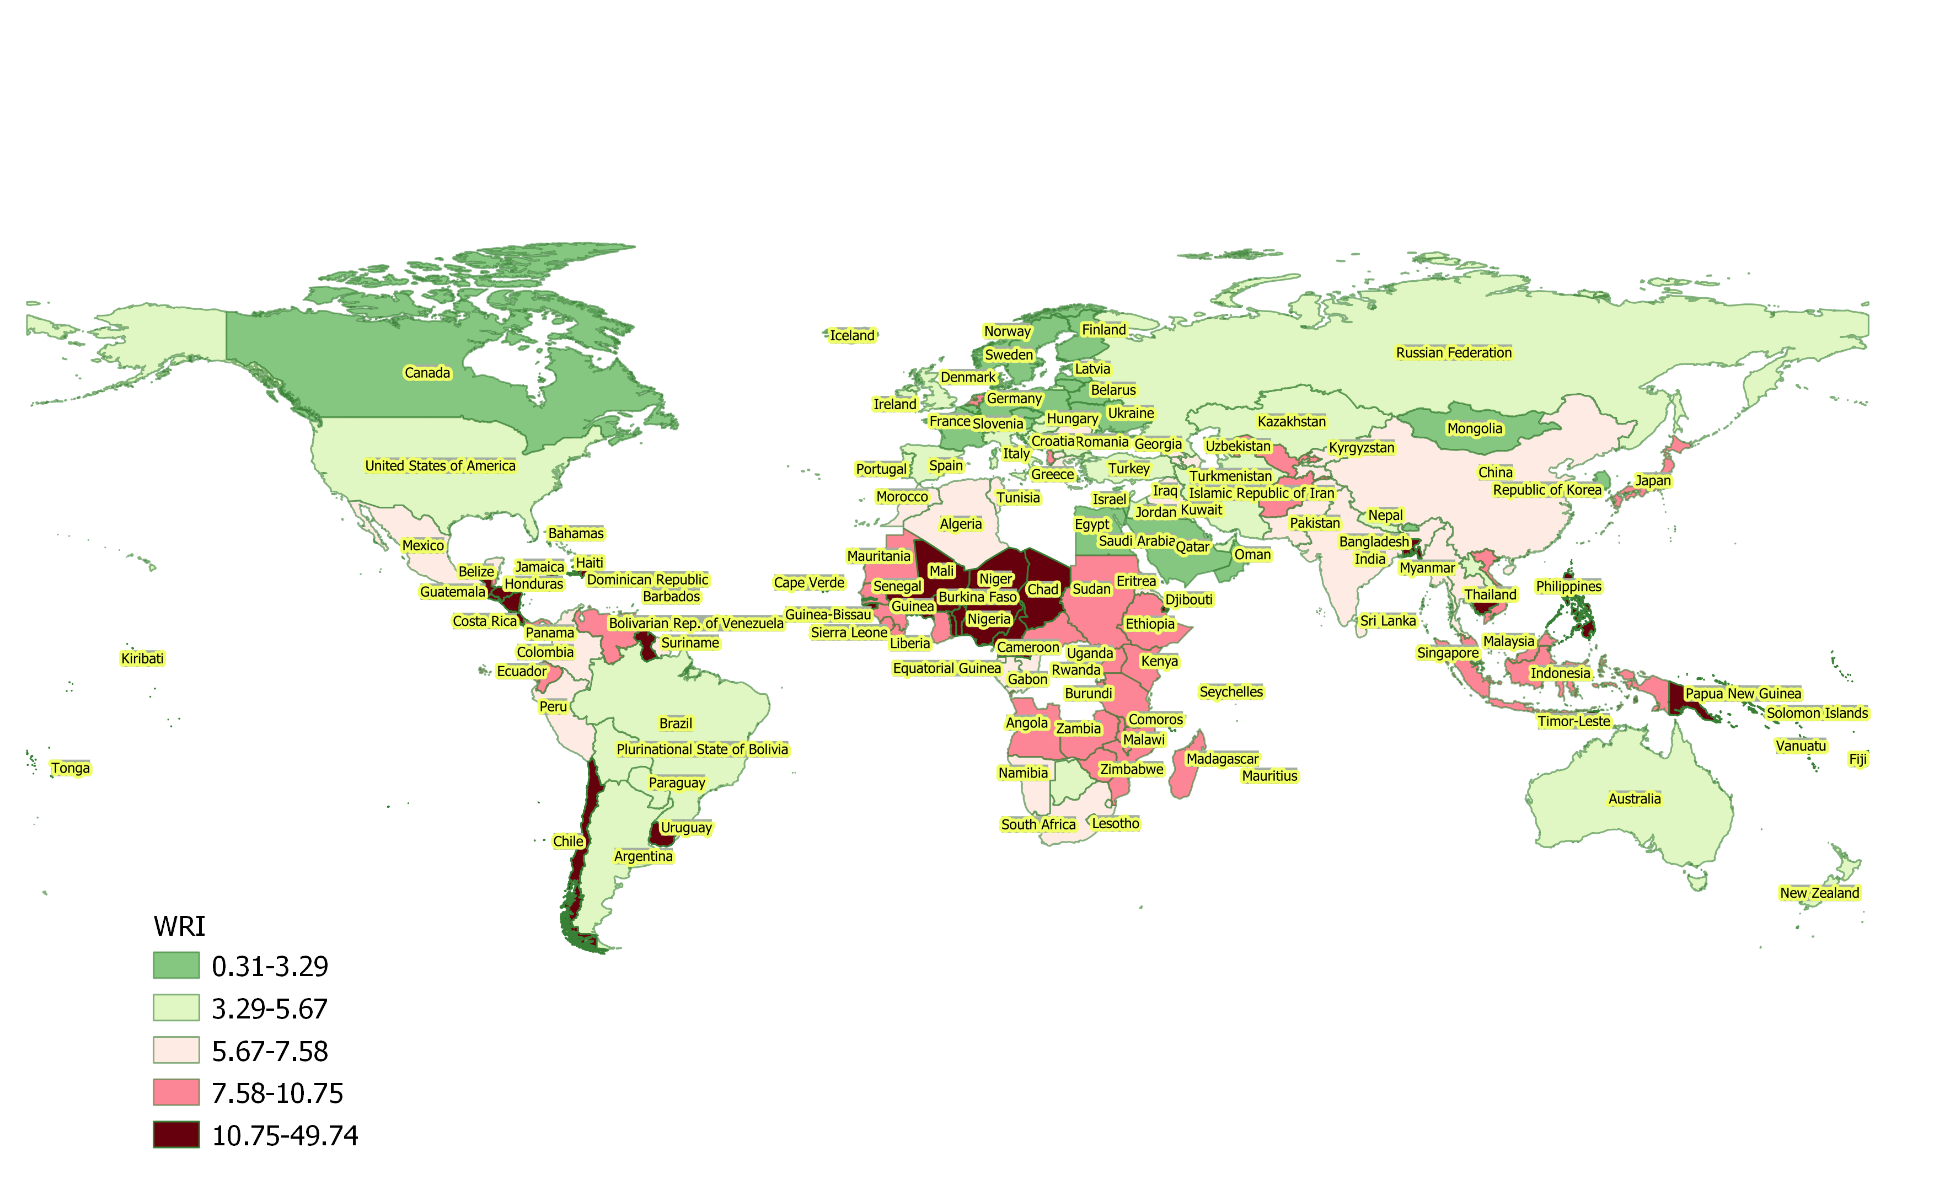
Linking Disaster Risk and
Environmental Sustainability
JONNEL S. ACOBA, THE MAXWELL SCHOOL OF CITIZENSHIP AND PUBLIC AFFAIRS
WORLD RISK INDEX

Slide 3
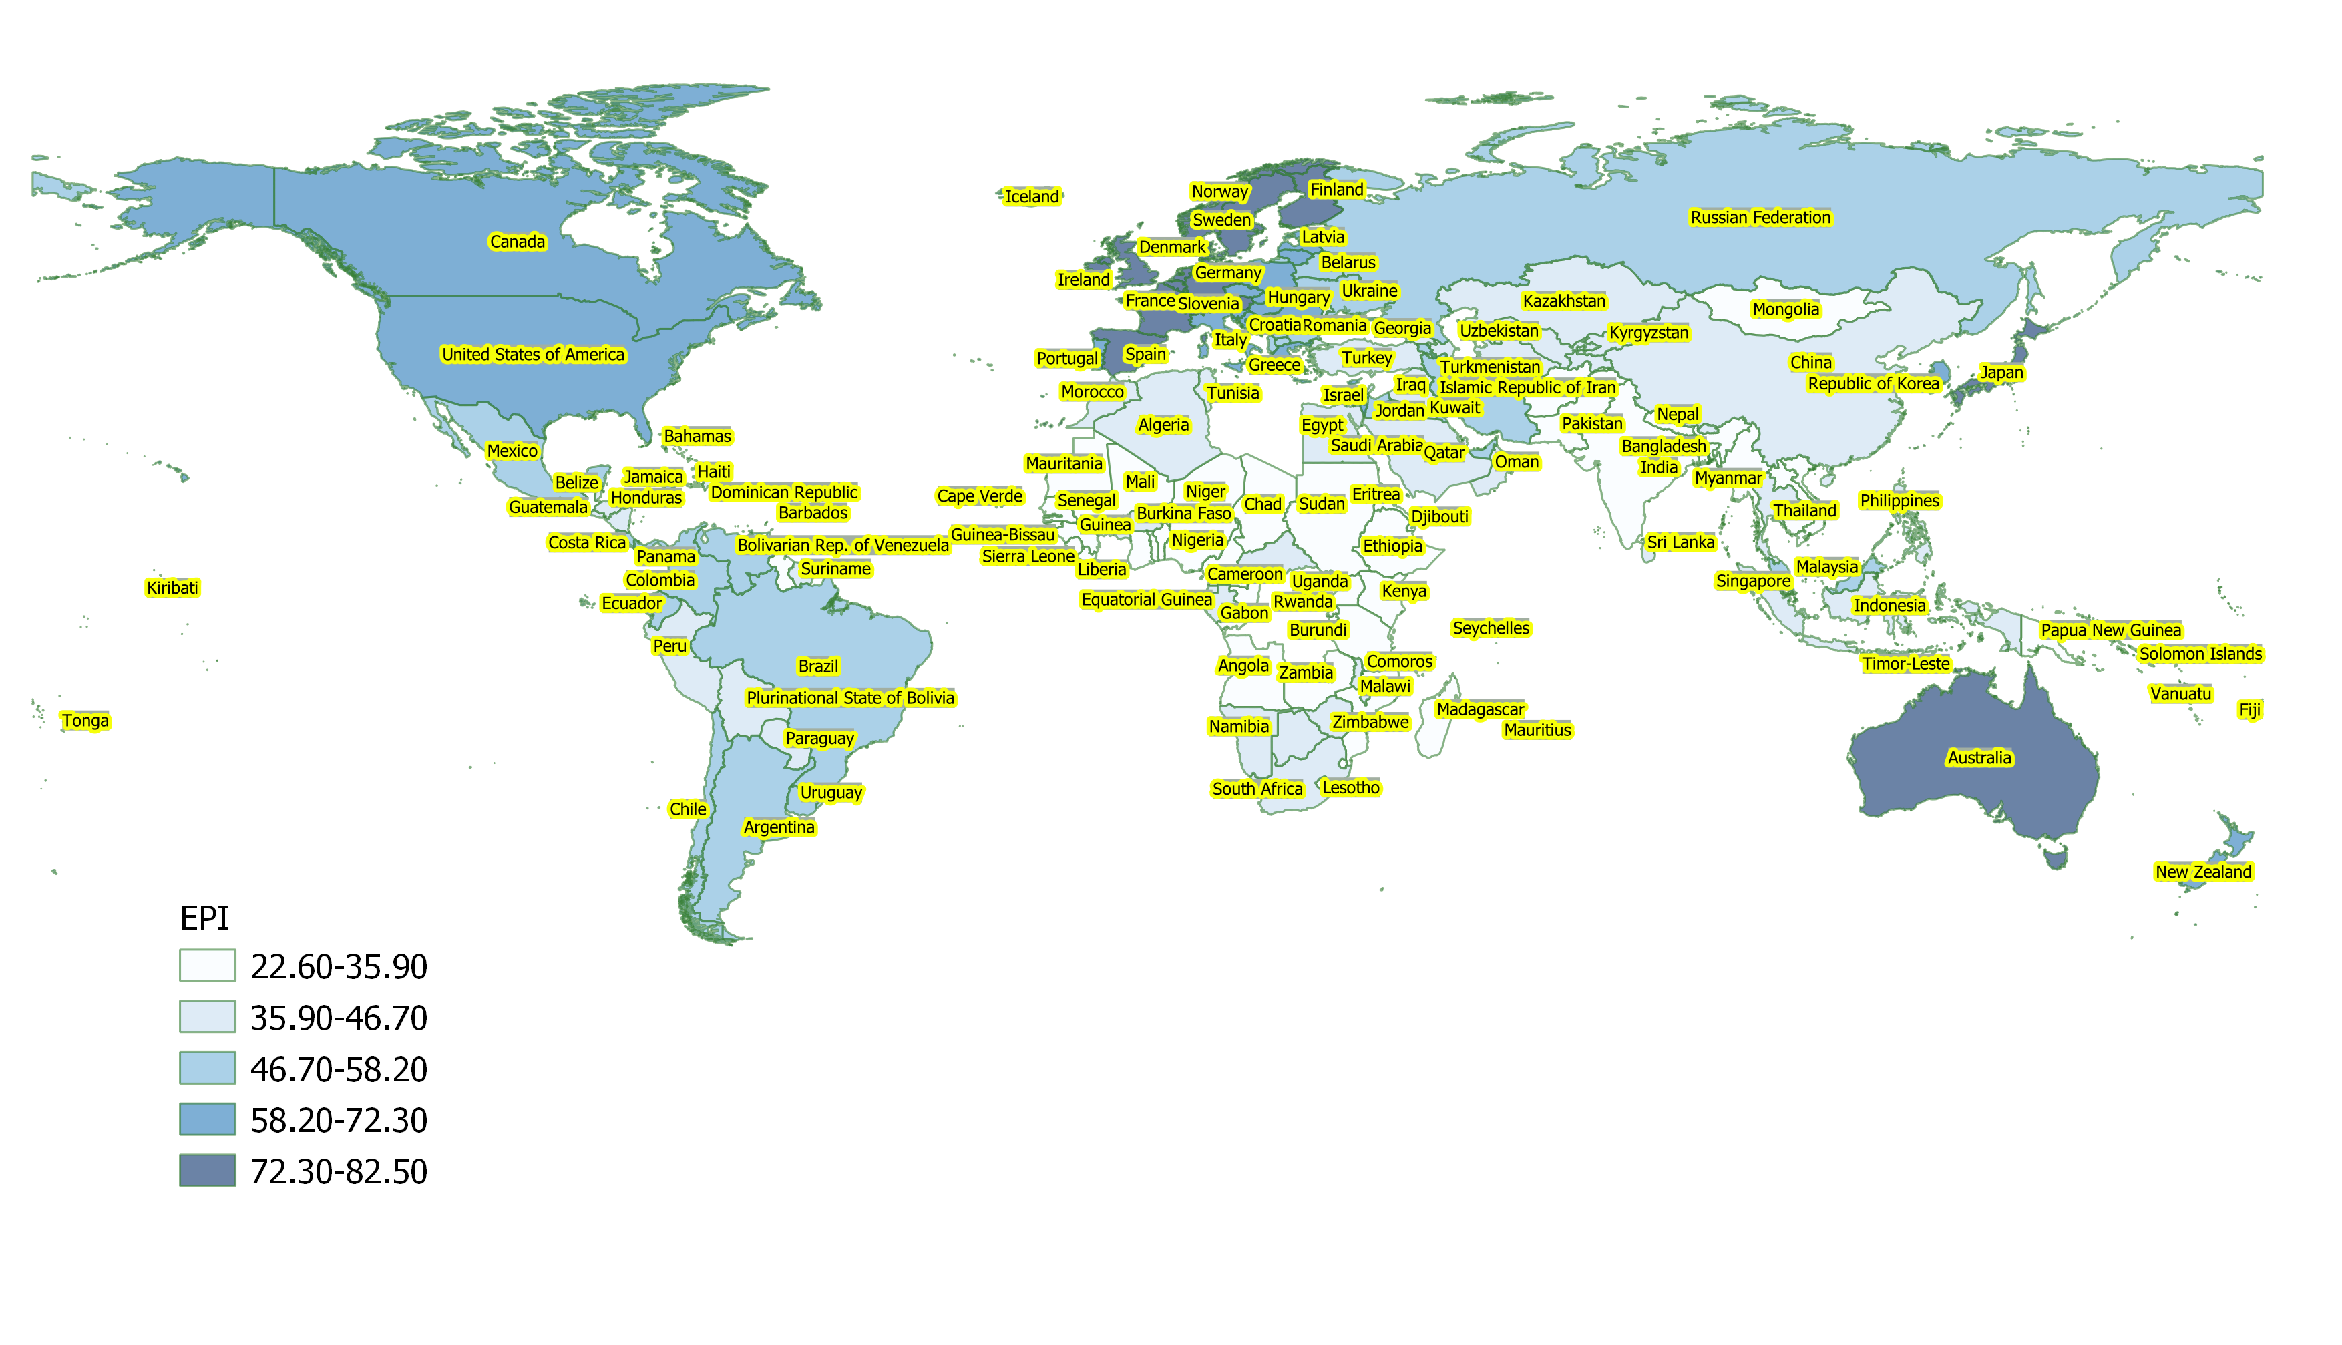
Linking Disaster Risk and
Environmental Sustainability
JONNEL S. ACOBA, THE MAXWELL SCHOOL OF CITIZENSHIP AND PUBLIC AFFAIRS
Environmental Performance index

